Slide 1
SRI RAMAKRISHNA ENGINEERING COLLEGE
[Educational Service: SNR Sons Charitable Trust]
[Autonomous Institution, Reaccredited by NAAC with ‘A+’ Grade]
[Approved by AICTE and Permanently Affiliated to Anna University, Chennai]
[ISO 9001:2015 Certified and all eligible programmes Accredited by NBA]
VATTAMALAIPALAYAM, N.G.G.O. COLONY POST, COIMBATORE – 641 022
Batch No:3IT15
20IT281 – Mini Project II
“PREDICTIVE CROWD MANAGEMENT AND RESOURCE ALLOCATION FOR PUBLIC SECTORS”
SDG GOALS MAPPED Nos. :09,11,16
Type of Project: Application / Society Based
Presented by
Haran M K – 71812405021
Harisekaran G – 71812405025
Kanagaraj P– 71812405045
Supervised by
Mrs.M.Princy
AP/IT
Zeroth Review
Date : 25.07.2026

Slide 2
Contents
S.No | Description | Slide Number
1 | Introduction | 3
2 | Literature Survey | 4-8
3 | Problem identification, scope and objective | 9-10
4 | Existing technology of the project | 11-12
5 | Methodology (Flow Diagrams) | 13
6 | Proposed Out come and Technical Feasibility | 14
7 | Time Line | 15
8 | SDG Goals & References | 16&17

Slide 3
Introduction
Existing government queue systems primarily use physical/digital tokens and appointment scheduling to manage citizens in a First-Come-First-Served manner.
These systems provide basic queue information but have limited ability to dynamically predict waiting time or anticipate crowd congestion.
Government service time varies depending on service type, document verification, citizen arrival rate, queue length, and counter/officer availability.
The proposed system integrates digital appointment booking, virtual queue management, and AI/ML-based waiting-time prediction into a unified platform.
The AI/ML model analyzes real-time queue data and historical patterns to predict waiting time and forecast potential queue congestion.
Citizens receive digital tokens, live queue positions, predicted waiting times, and turn notifications, reducing unnecessary physical waiting.
Administrators can monitor queues through a dashboard and receive crowd forecasts, queue analytics, and intelligent counter-allocation recommendations.

Slide 4
Literature Survey - 01
Experiment | Inference | Problem gap
Developed a machine-learning-based waiting time prediction system using historical queue data. The study formulates waiting-time prediction as a regression problem and evaluates ensemble regression models such as Random Forest, XGBoost, Gradient Boosting, and Extra Trees to estimate customer waiting time accurately. | The ensemble regression models achieved high prediction accuracy, with tree-based methods outperforming conventional regression techniques. The model provides reliable real-time waiting-time estimates, enabling better queue monitoring and service planning while reducing uncertainty for customers. | The proposed system mainly focuses on waiting-time prediction and does not include dynamic resource allocation, automatic counter management, appointment scheduling, or government-office workflows.commend opening additional service counters during peak crowd conditions.
Source: T. K. Taton et al., "Waiting Time Prediction in Queue Management: Leveraging Machine Learning Approach," Proceedings of the 2024 IEEE International Conference on Recent Progresses in Science, Engineering and Technology (ICRPSET), 2024, DOI: 10.1109/ICRPSET64863.2024.10955915

Slide 5
Literature Survey - 02
Experiment | Inference | Problem gap
Evaluated Random Forest, Extra Trees, Gradient Boosting, Histogram Gradient Boosting, Voting and Ridge Regression using historical bank queue data to predict numerical waiting time. | Tree-based ensemble ML models are effective for queue waiting-time prediction. The study found the Extra Trees Regressor to be the best-performing model among those evaluated. | The study mainly focuses on prediction accuracyusing historical bank data. It does not implement a complete government queue system with appointment booking, live citizen notifications and dynamic counter allocation.
Source: Tapodhir Karmakar Taton, Bipin Saha, Md. Johirul Islam and Shaikh Khaled Mostaque, “A Comprehensive Approach to Queue Waiting Time Prediction using Tree-Based Ensembles with Data Balancing and Explainable AI,” Discover Analytics, Vol. 3, Article 9, 2025, DOI: 10.1007/s44257-025-00037-2.

Slide 6
Literature Survey - 03
Experiment | Inference | Problem gap
Developed a machine learning-based patient waiting-time prediction model using historical hospital data to estimate treatment time and reduce queue delays. | The predictive model improved waiting-time estimation and supported better queue planning and resource utilization. | The system is designed for hospital queues only. It does not support government office workflows, dynamic counter allocation, appointment scheduling, or citizen token management.
Source: Mai Abusair, Mohammad Sharaf, Tuqa Hamad, Raghad Dahman et al., "Reducing Patient Waiting Time at Public Hospitals Through Predictive Modeling," IEEE ZCICT 2024, DOI: 10.1109/ZCICT63770.2024.10958517.

Slide 7
Literature Survey - 04
Experiment | Inference | Problem gap
Developed a machine-learning-based queue length detection system using video surveillance data. The study formulates queue length detection as a regression problem.The system estimates the number of people waiting in a queue from camera frames to support efficient queue monitoring in public institutions. | The ensemble regression models achieved high prediction accuracy, with tree-based methods outperforming conventional regression techniques. The model provides reliable real-time waiting-time estimates, enabling better queue monitoring and service planning while reducing uncertainty for customers. | The proposed system mainly focuses on waiting-time prediction and does not include dynamic resource allocation, automatic counter management, appointment scheduling, or government-office workflows.owd conditions.
Source: Mehmet Eren Yeşilyurt et al., "A Comparison of Machine Learning Methods for Queue Length Detection," Communications Faculty of Sciences University of Ankara, Vol. 66, No. 2, pp. 132–139, 2024. DOI: 10.33769/aupse.1415447.

Slide 8
Literature Survey - 05
Experiment | Inference | Problem gap
Reviews existing queue-management studies and proposes an integrated framework combining queue-state data capture, feature engineering, ML waiting-time prediction, dynamic counter allocation and monitoring for public services. | Combining waiting-time prediction with dynamic counter allocation can support better resource utilization, congestion management and transparent public-service delivery. | The work primarily proposes a framework based on reviewed literature; extensive real-world implementation and cross-domain validation are still required.
Source: Dr. Balamurugan S. and Dhanush S., “ML-Based Smart Queue Management System for Public Services,” IRE Journals, Vol. 9, Issue 11, pp. 2662 onward, May 2026, ISSN: 2456-8880, DOI: 10.64388/IREV9I11-1717976

Slide 9
Problem identification, scope and objectives (Contd.,)
Problem Definition :
Government offices face long queues, overcrowding, and unpredictable waiting times, especially during peak hours.
Existing token-based systems mainly manage queue order but lack dynamic waiting-time prediction and congestion forecasting.
Variations in service time, queue length, citizen arrivals, and counter availability make effective queue management difficult.
Therefore, an AI-based adaptive queue management system is required for efficient and predictable public service delivery.
Scope:
Online appointment booking and digital token generation.
Virtual queue and real-time queue tracking.
AI/ML-based waiting-time prediction using real-time and historical data. Crowd forecasting to identify peak periods and congestion.
Intelligent counter-allocation recommendations for administrators.
Real-time notifications and queue updates for citizens.
Scalable to multiple Tamil Nadu government offices and services.

Slide 10
Problem identification, scope and objectives
Objectives :
To develop an intelligent digital queue management system that enables citizens to book appointments, generate digital tokens, and track their live queue position.
To implement an AI/ML-based prediction model for dynamically estimating citizen waiting time and forecasting queue congestion using real-time and historical queue data.
To optimize government service operations by providing intelligent counter-allocation recommendations, real-time queue updates, and turn notifications to reduce waiting time and overcrowding.

Slide 11
Existing technology of the project
Existing queue management systems use physical/electronic token generation to maintain the order of customers or citizens.
Online appointment and virtual queue systems allow users to reserve service slots and remotely monitor queue status.
Traditional waiting-time estimation commonly depends on queue length, average service time, and predefined/static rules.
Recent research applies Machine Learning regression models to historical and real-time queue information for more accurate waiting-time prediction.
Ensemble ML techniques such as Random Forest, Extra Trees, and Gradient Boosting have been investigated for queue waiting-time prediction.
Existing research demonstrates that ML can improve waiting-time estimation, but integrating dynamic prediction, congestion forecasting, and resource/counter recommendations into one government-service platform remains an important area for development.
Source: Waiting Time Prediction in Queue Management: Leveraging Machine Learning Approach,” T. K. Taton et al., IEEE, 2024/2025. The study investigates machine-learning-based queue waiting-time prediction as a regression problem using ensemble methods

Slide 12
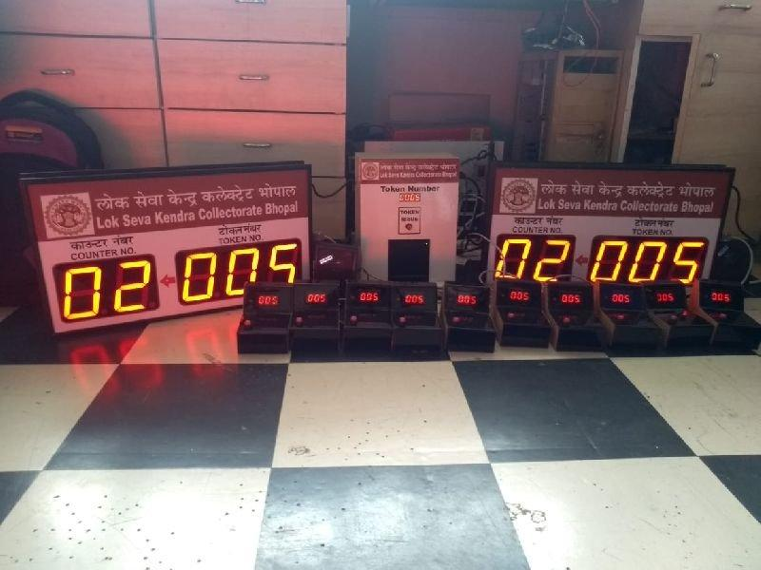

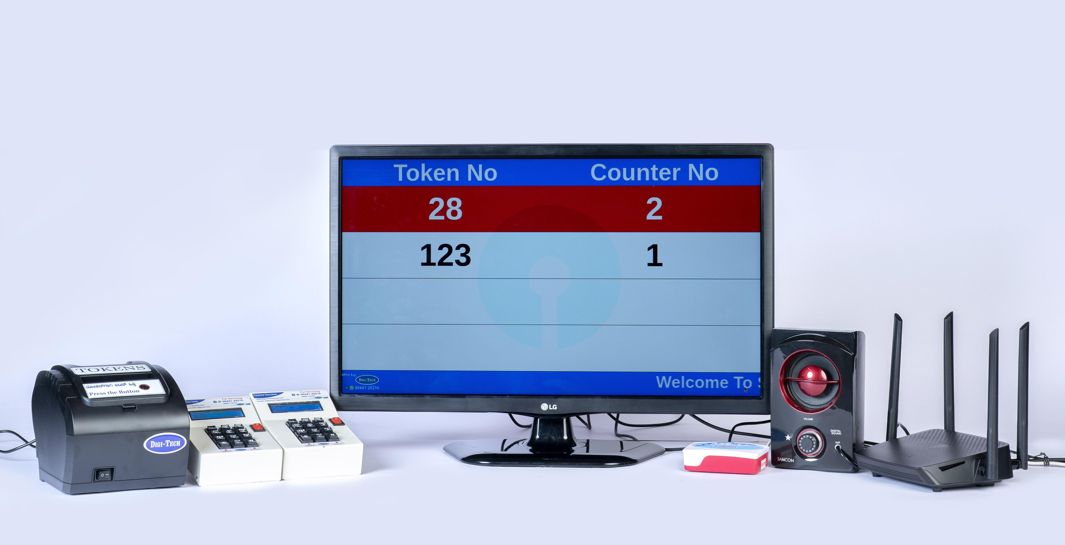
Existing technology of the project
Photographs:
Existing systems primarily rely on physical queues, digital tokens, appointment scheduling, and electronic queue displays for managing citizen services.

Slide 13
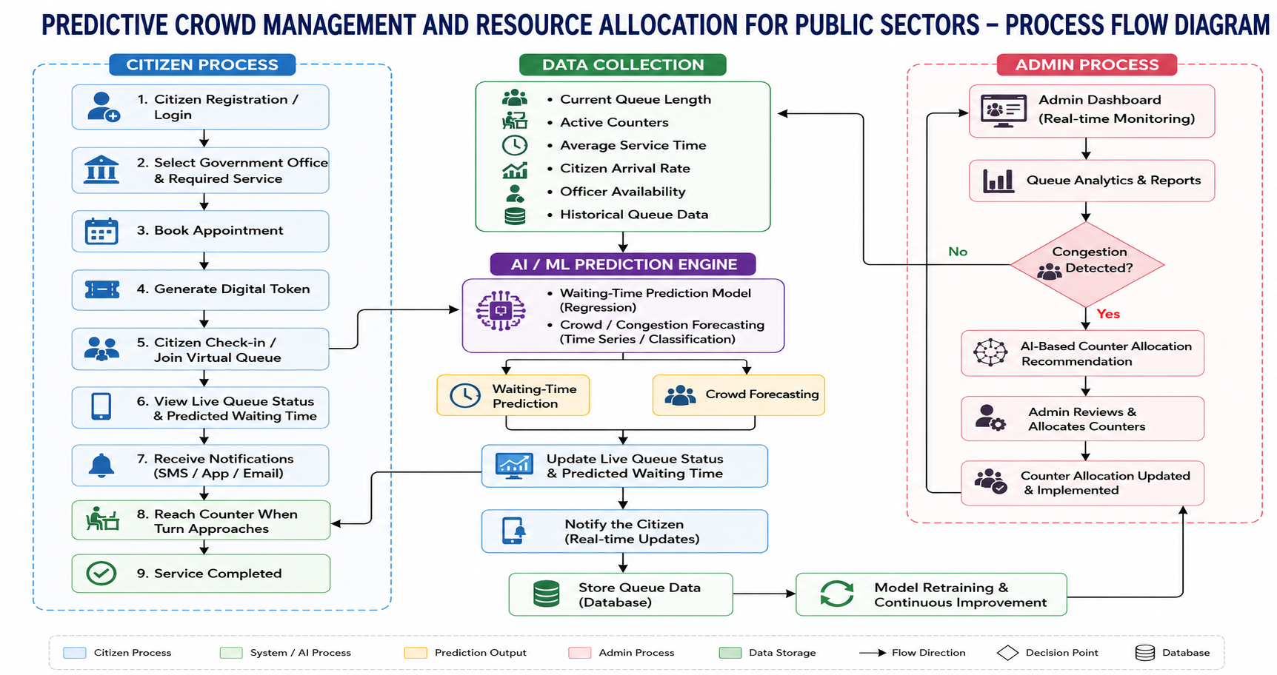
Methodology
Process Flow Diagram

Slide 14
Technical feasibility
Web Application Development: React.js and Bootstrap provide a responsive and user-friendly interface for citizens, officers, and administrators.
Backend & Database: Node.js, Express.js, and MongoDB support appointment booking, digital tokens, queue management, user data, and historical queue records.
AI/ML Implementation: Python and Scikit-learn are used to develop models for waiting-time prediction and crowd forecasting using real-time and historical queue data.
Real-Time Queue Updates: The system continuously updates queue position, current token, counter availability, and predicted waiting time.
Notification Service: Firebase can provide appointment reminders, queue updates, and turn notifications to citizens.
Scalability: The system can initially support selected government offices and can later be extended to multiple departments and locations.
Technology Stack
Frontend: React.js + Bootstrap
Backend: Node.js + Express.js
Database: MongoDB
AI/ML: Python + Scikit-learn
ML Integration: Flask / FastAPI

Slide 15
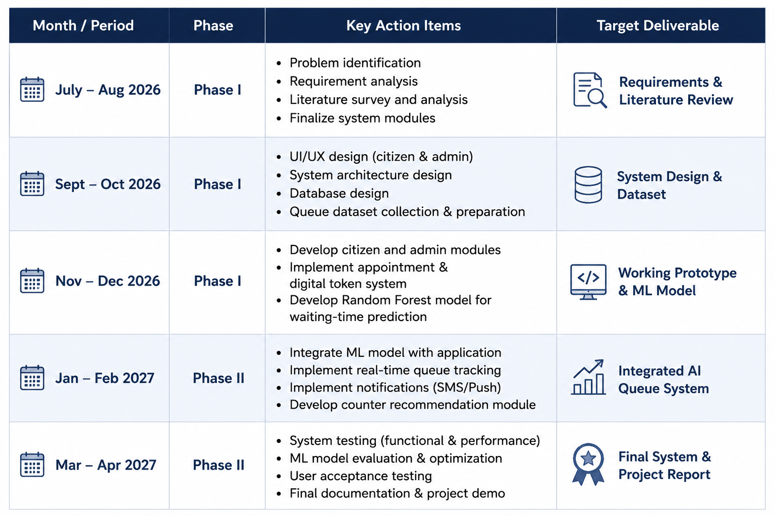
Time line
Month / Period | Phase | Key Action Items | Target Deliverable
July – Aug 2026 | Phase I
Sept – Oct 2026 | Phase I
Nov – Dec 2026 | Phase I
Jan – Feb 2027 | Phase II
Mar – Apr 2027 | Phase II

Slide 16
SDG Goals
SDG 9 – Industry, Innovation and Infrastructure
Promotes the use of AI/ML and digital technologies in government service infrastructure.
Supports the modernization of traditional queue-management systems through intelligent automation and data-driven solutions.
SDG 11 – Sustainable Cities and Communities
Helps reduce overcrowding and unnecessary physical waiting at government offices.
Supports smarter and more accessible public-service delivery through digital appointments and virtual queues.
SDG 16 – Peace, Justice and Strong Institutions
Improves the efficiency, accessibility, and transparency of government service delivery.
Enables better queue monitoring and resource utilization through AI-based predictions and administrative decision support.

Slide 17
References
[1] T. K. Taton et al., “Waiting Time Prediction in Queue Management: Leveraging Machine Learning Approach,” Proceedings of the 2024 IEEE International Conference on Recent Progresses in Science, Engineering and Technology (ICRPSET), 2024, doi: 10.1109/ICRPSET64863.2024.10955915.
[2] T. K. Taton, B. Saha, M. J. Islam and S. K. Mostaque, “A Comprehensive Approach to Queue Waiting Time Prediction Using Tree-Based Ensembles with Data Balancing and Explainable AI,” Discover Analytics, vol. 3, article 9, 2025, doi: 10.1007/s44257-025-00037-2.
M. Abusair, M. Sharaf, T. Hamad, R. Dahman et al., “Reducing Patient Waiting Time at Public Hospitals Through Predictive Modeling,” IEEE ZCICT 2024, 2024, doi: 10.1109/ZCICT63770.2024.10958517.
[4] M. E. Yeşilyurt et al., “A Comparison of Machine Learning Methods for Queue Length Detection,” Communications Faculty of Sciences University of Ankara, vol. 66, no. 2, pp. 132–139, 2024, doi: 10.33769/aupse.1415447.
[5] S. Balamurugan and S. Dhanush, “ML-Based Smart Queue Management System for Public Services,” IRE Journals, vol. 9, no. 11, May 2026, doi: 10.64388/IREV9I11-1717976

